Slide 1
Human Activity Recognition
Daksh Shah
Parth Sharma
Zheng Duan

Slide 2
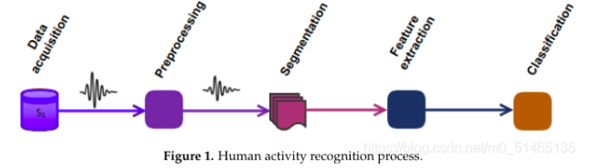
Introduction
Human activity recognition (HAR) is a challenging time series multi-classification task.
Activity recognition is the problem of predicting day-to-day human activities based on sensor data.
This dataset represents ambient data collected in homes with volunteer residents. Data are collected continuously while residents perform their normal routines.
Notes:
Human activity recognition is a broad area of research that involves recognizing specific human movements based on sensor data. The movements are usually typical activities such as walking, standing, sitting, lying down, going up and down stairs, etc. They may also be more focused activities, such as those types of activities performed in a kitchen or on a factory floor. Sensor data can be recorded remotely, such as video, radar or other wireless methods. Alternatively, the data can be recorded directly on the object by carrying custom hardware or a smartphone with accelerometers and gyroscopes.

Slide 3
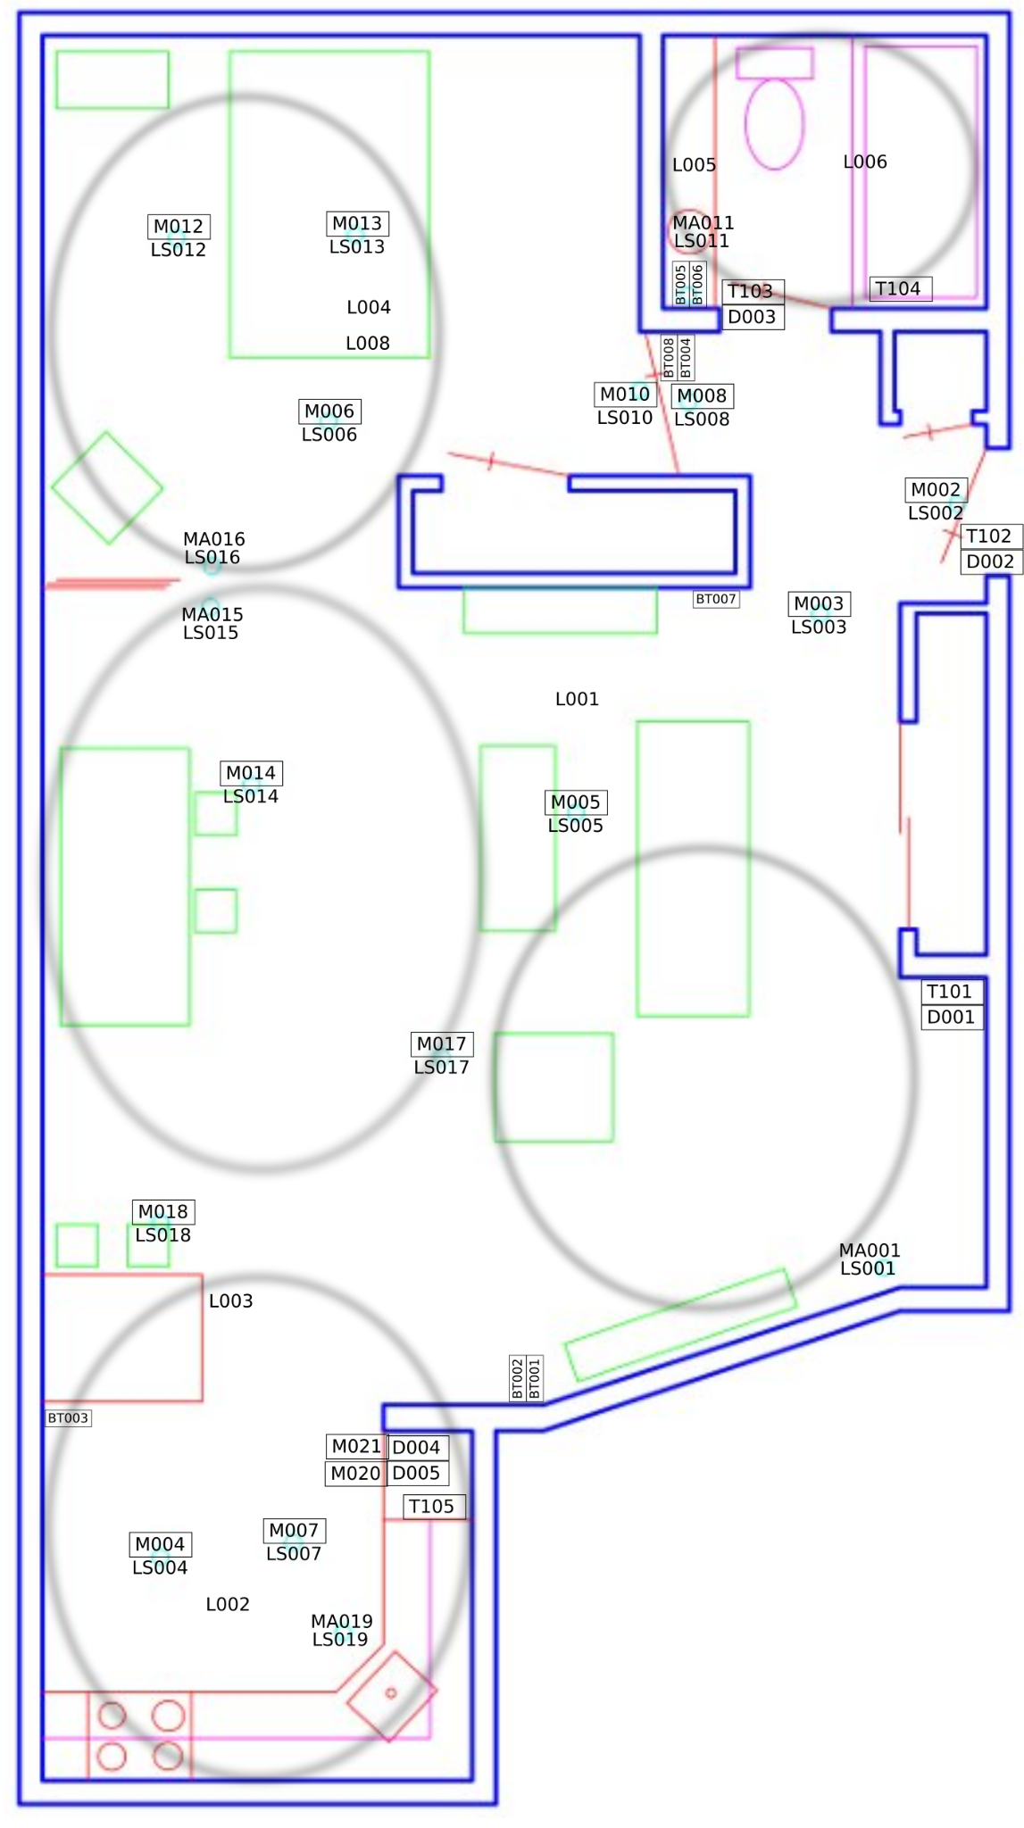
Introduction
Data Collection Data Processing Model training Activity Inference
Numerical and Categorical features extracted and combined
EDA with Univariate and Bivariate and multivariate Analysis
Data Cleaning
Data Transformation for Modelling
Decision Tree
Random Forest
OnevsOneClassifier
OnevsRestClassifier
XGBoost
Sleeping
Preparing for Meal
Eating
Getting Ready
Entering/Leaving Home
Entertaining Guests
Watching TV
Washroom
Other Activity
Notes:
Historically, sensor data for activity recognition has been challenging and time-consuming to collect, and may require custom hardware. Now that the widespread use of smartphones for fitness and health monitoring and other personal tracking devices has made sensor data from these devices more readily available, research efforts targeting human activity recognition have focused on data from these hardware phones. The problem is to predict the class of activity based on sensor data, which is usually one-dimensional or multidimensional. Typically, this problem can be modeled as a univariate or multivariate time series classification task.
This is a challenging problem because there is no obvious or direct way to relate the recorded sensor data to a specific human activity and each object may perform activities with significant variation, resulting in changes in the recorded sensor data. The goal is to record object-specific sensor data and corresponding activities, fit a model from that data, and generalize the model to classify the activities of new unseen objects based on their sensor data.

Slide 4
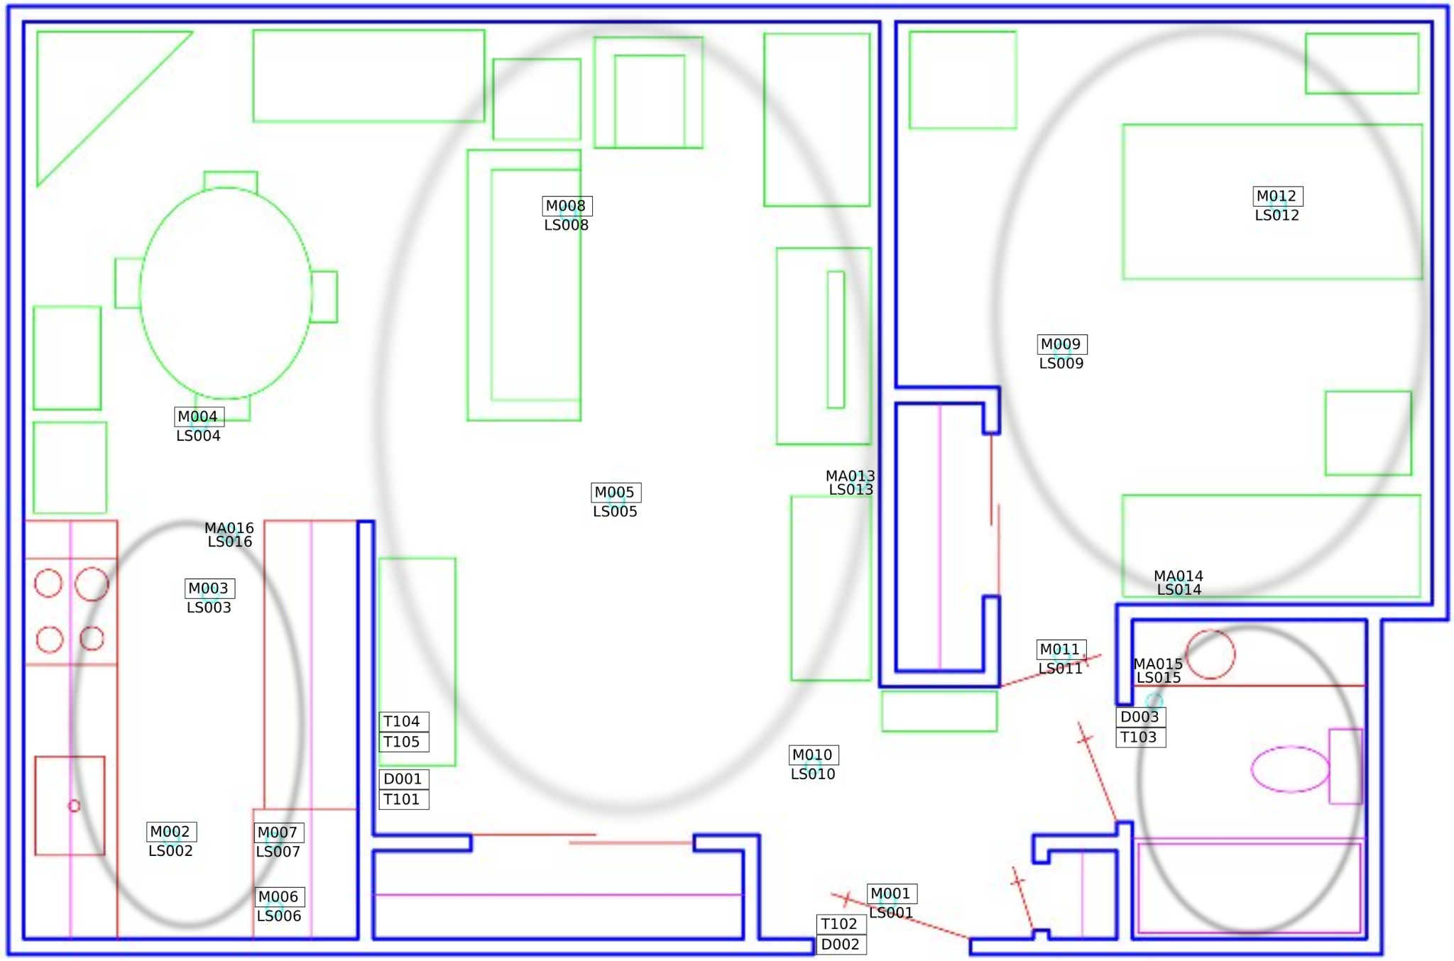
Data Collection
Ambient PIR motion sensors, door/temperature sensors, and light switch sensors are placed throughout the home of the volunteer.
The sensors are placed in locations throughout the home that are related to specific activities of daily living that we wish to capture.
Notes:
This dataset represents ambient data collected in homes with volunteer residents. Data are collected continuously while residents perform their normal routines. Ambient PIR motion sensors, door/temperature sensors, and light switch sensors are placed throughout the home of the volunteer. The sensors are placed in locations throughout the home that are related to specific activities of daily living that we wish to capture.\newline
The data for numerical and categorical features are captured separately. We had to find an innovative way to stitch the data sets since some data points were not captured in the other data set and we didn't have any primary key to merge the common data points.\newline
We then carried out the standard data pre-processing which includes,checking for duplicates and missing values, treating outliers of some numerical variables, label encoding the categorical features, MinMax scaling the numerical features and splitting the data into train, test and validation using stratified sampling to maintain the target proportion.\newline

Slide 5
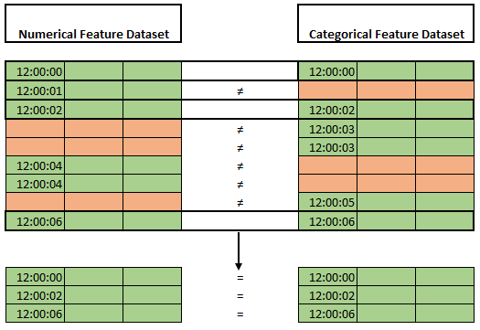
Data Compilation
The data for numerical and categorical features are captured separately.
To merge the data sets, we have to find the data points which were not captured in the other data set and exclude them from our analysis.
Since de didn’t have any primary key to merge the data sets, we used the date-time columns to find the common data points in both the pool.
It was challenging to do so since the Numerical dataset didn’t have the date column to identify the day and we had to use a logic to extract it using the categorical dataset.

Slide 6
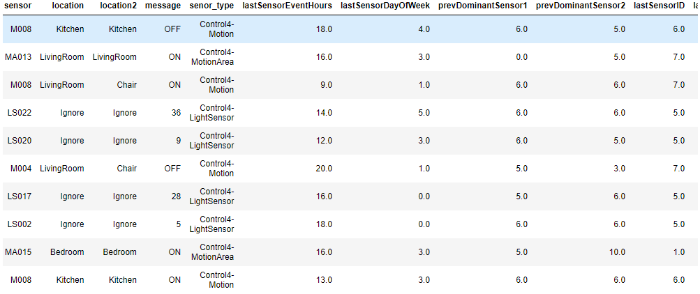
EDA - Univariate Analysis
12 Categorical features

Slide 7
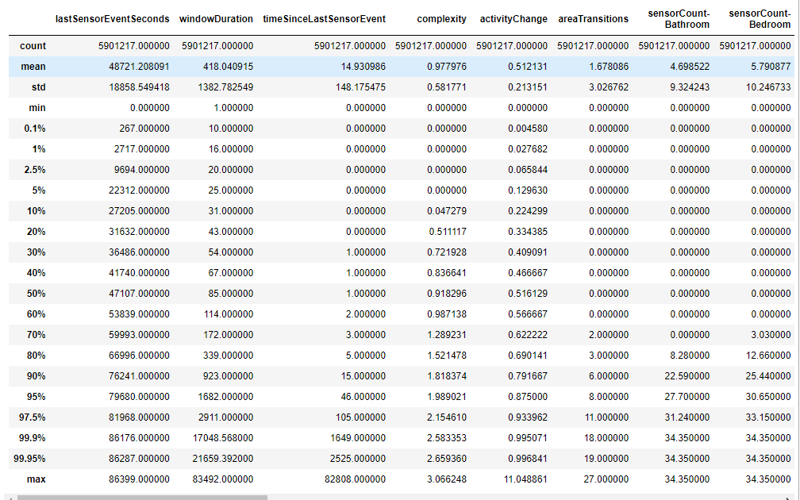
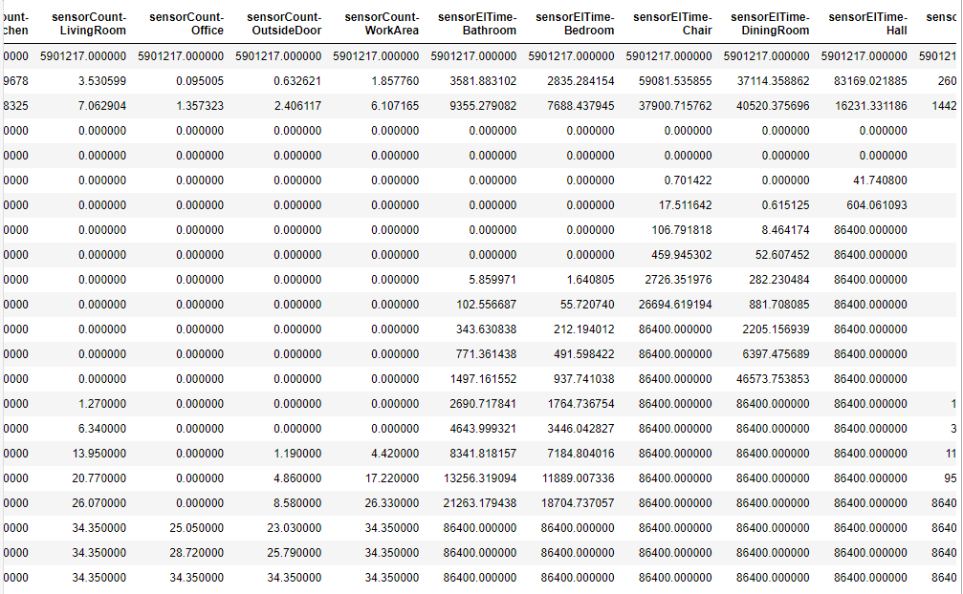
EDA - Univariate Analysis
Percentile Distribution of 28 Numerical features

Slide 8
Data Cleaning and Preprocessing
Outlier Treatment: Variables “Activity change” and “Area transition” limited to their 97.5% percentile value
Grouping of Sensor messages:
Grouped output messages from light sensor into 10 clusters based on their distribution
Grouped output messages from temperature sensor into 3 clusters based on their distribution (Hot, Medium, Cold)
Grouping of Target Variable:
Some of the target variables were grouped in order to reduce the target dimension, for e.g., Eat_lunch, Eat_dinner, Eat_breakfast were combined to one target variable “Eat”.
Scaling and Encoding:
Used MinMaxScaler for Numerical Variables
Used Label Encoder for Categorical Variables
Train Test Split:
Used data from each of the 30 homes and split the data into train and test using stratified sampling to maintain the target proportion.

Slide 9
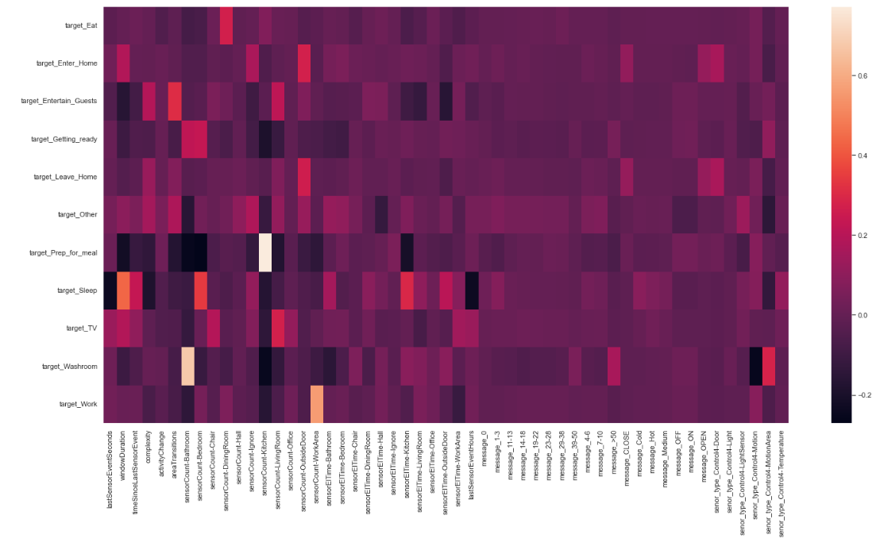
EDA - Bivariate Analysis
Correlation Heatmap
We can see that sensor counts of specific locations are co-related to its respective activity.
Notes:
This dataset represents ambient data collected in homes with volunteer residents. Data are collected continuously while residents perform their normal routines. Ambient PIR motion sensors, door/temperature sensors, and light switch sensors are placed throughout the home of the volunteer. The sensors are placed in locations throughout the home that are related to specific activities of daily living that we wish to capture.
The data for numerical and categorical features are captured separately. We had to find an innovative way to stitch the data sets since some data points were not captured in the other data set and we didn't have any primary key to merge the common data points.

Slide 10
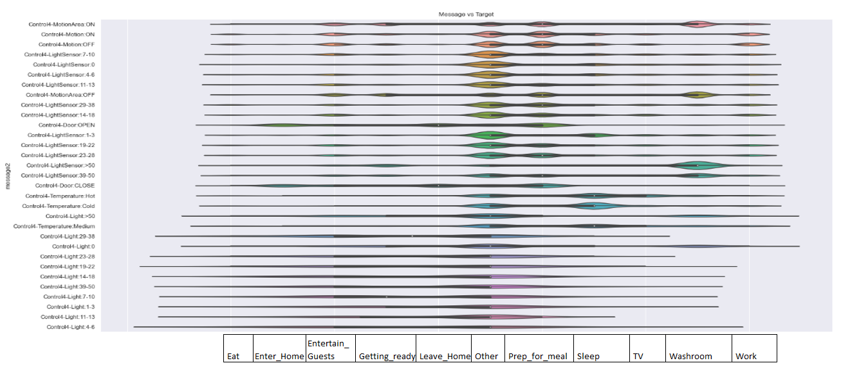
EDA - Bivariate Analysis
Sensor Message vs Target Frequency
We can also see some of the messages from a sensor type is also co-related to specific set of activities. For e.g., change in temperature reading is co-related to sleeping, increase in Light and Motion sensor count is co-related to washroom.

Slide 11
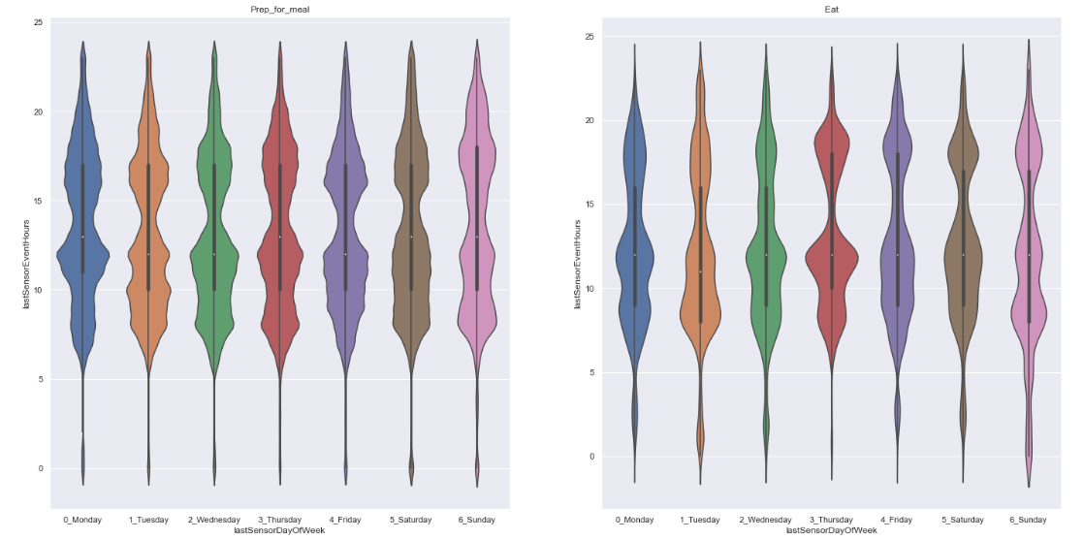
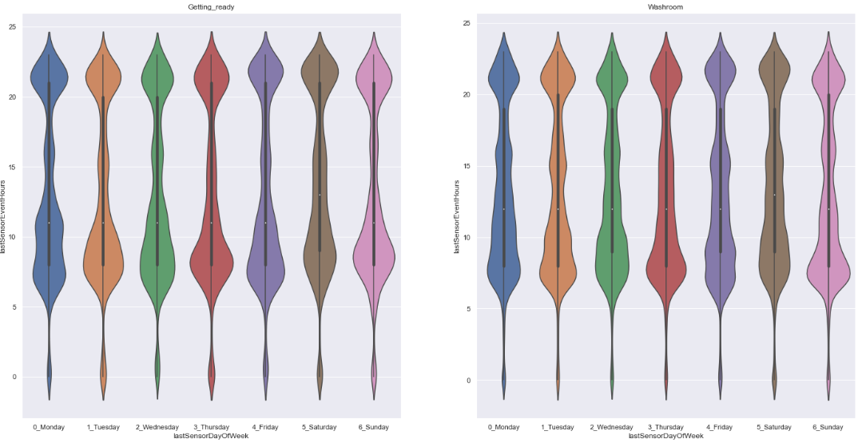
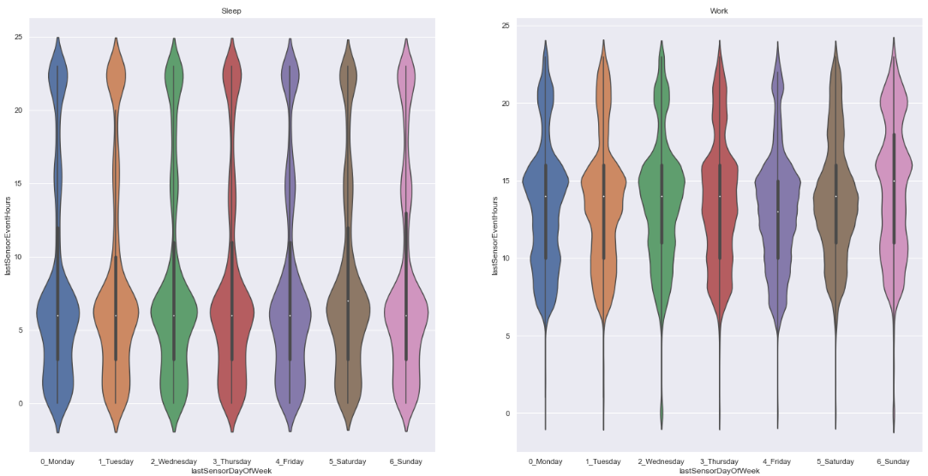
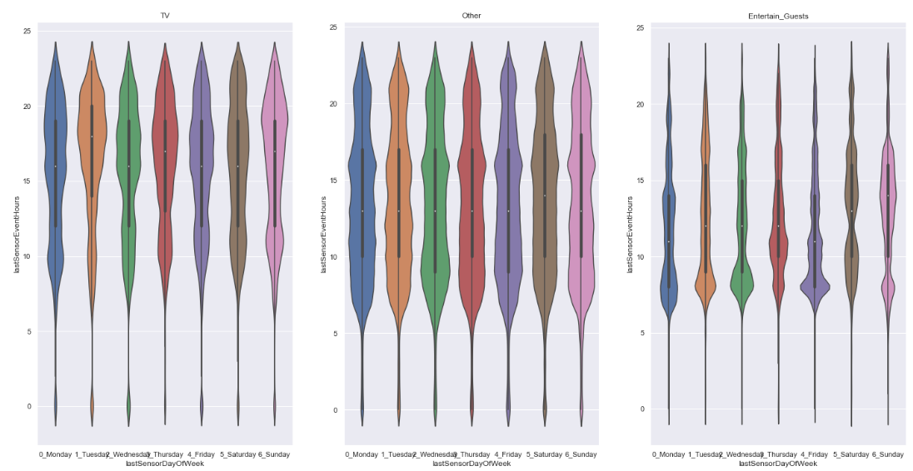
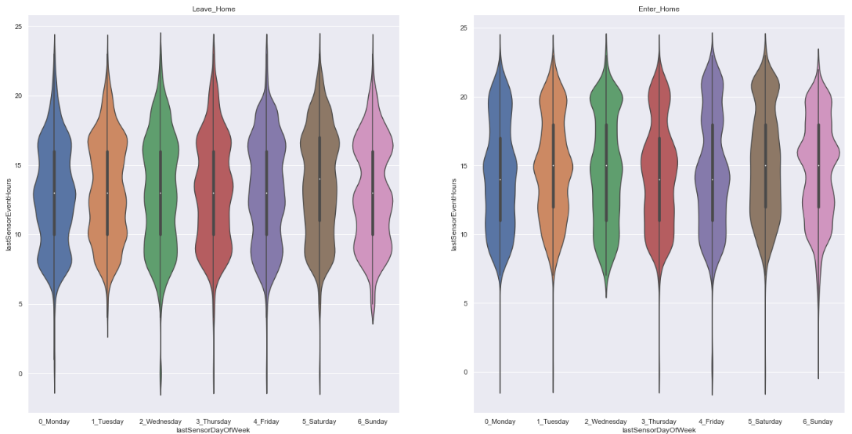
EDA - Multivariate Analysis
Co-relation of hour of the day vs Activities:
Sleep - 10 pm to 10 am.
Work - 10 am to 10pm
Getting Ready and Washroom/
Prepping for meal and eating, both of them seem to go hand in hand
Hour of the week vs Target Frequency

Slide 12
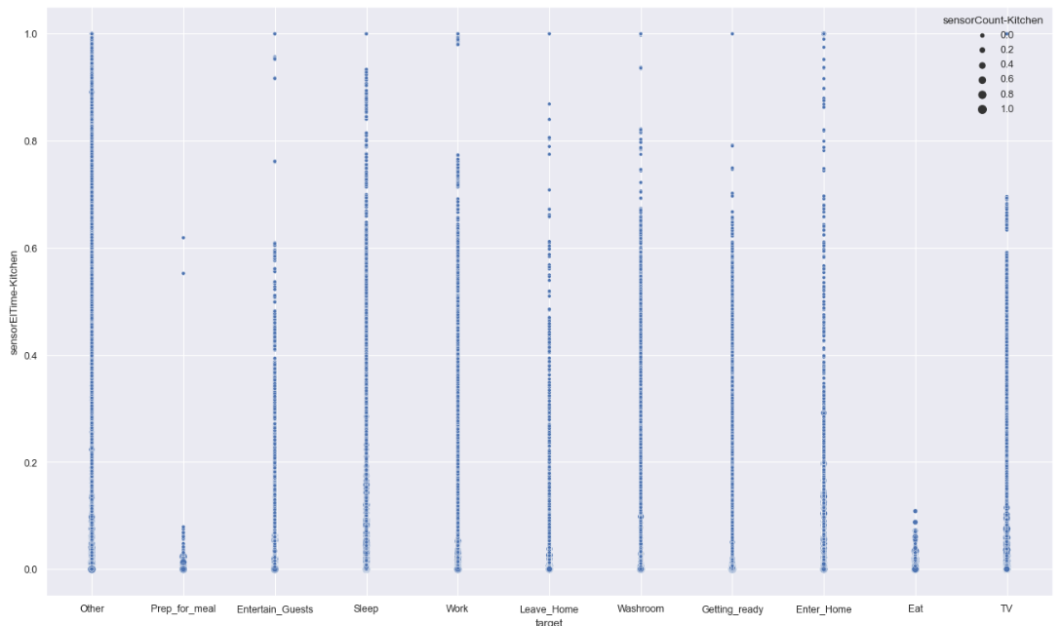
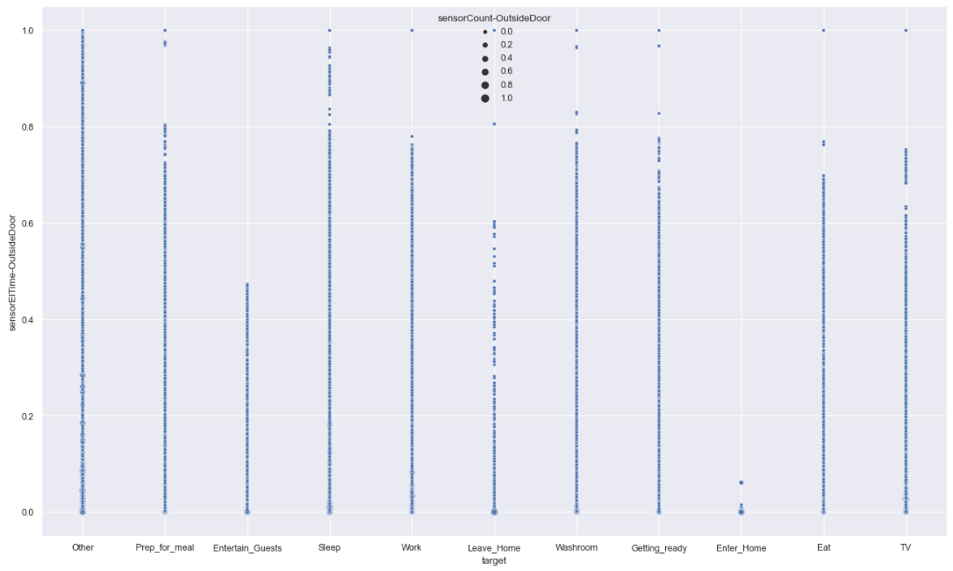
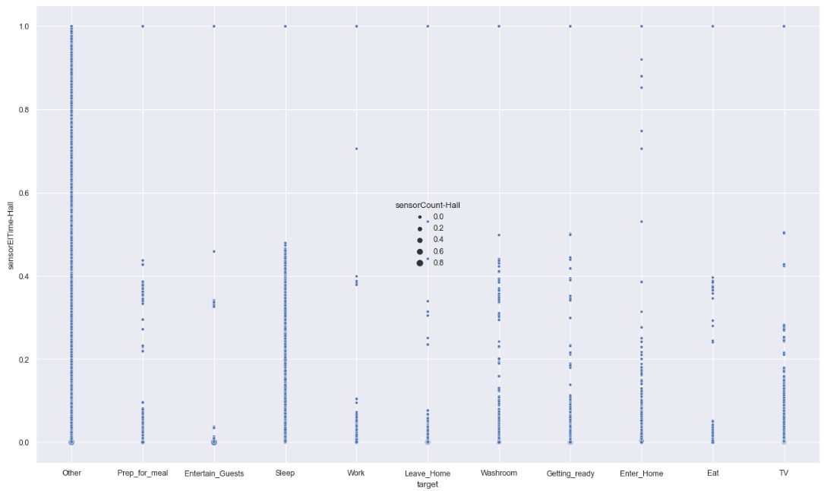
EDA - Multivariate Analysis
A mix of Sensor count and time since last sensor capture are co-related to specific activities, such as,
Kitchen sensor having high sensor count and low sensor time are co-related to prepping for meal or eating.
Bedroom sensor having high sensor count and low sensor time are co-related to sleeping.
Sensor count and time vs Target Bubble-plot
Notes:
We can also see some of the messages from a sensor type is also co-related to specific set of activities. For e.g., change in temperature reading is co-related to sleeping, increase in Light and Motion sensor count is co-related to washroom

Slide 13
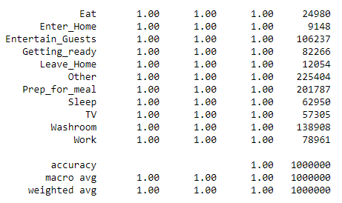
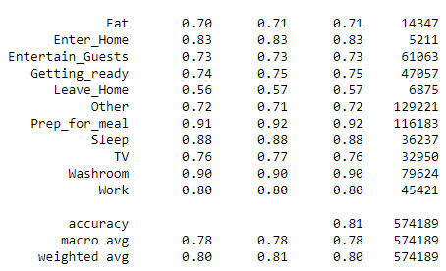
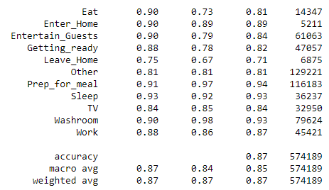
Data Modelling
Decision Tree
Random Forest
Train
Test
Notes:
Overfitting
RF>DT

Slide 14
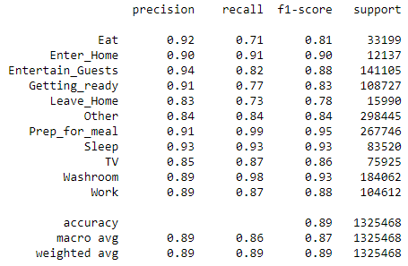
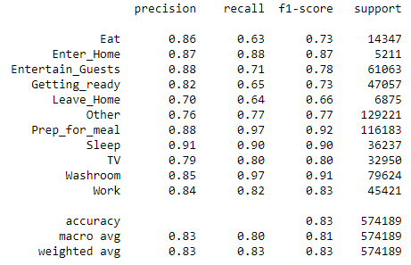
Data Modelling
Hyper-parameter Tuned Random Forest
Train
Test
Notes:
Resolved Overfitting
But comprised a bit on test accuracy
Also Not scalable (Model size >7GB)

Slide 15
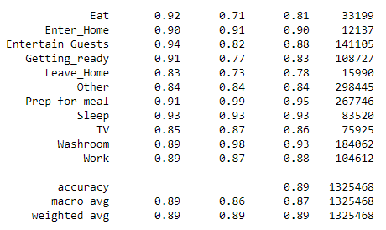
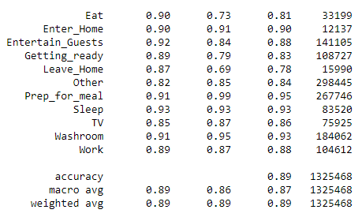
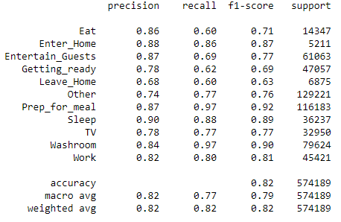
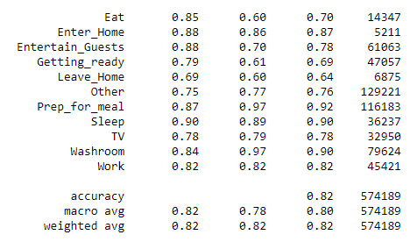
Data Modelling
OneVsOne RF
OneVsRest RF
Train
Test
Notes:
Similar results as hyper tuned RF

Slide 16
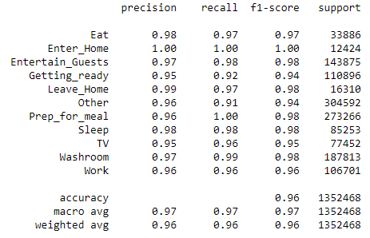
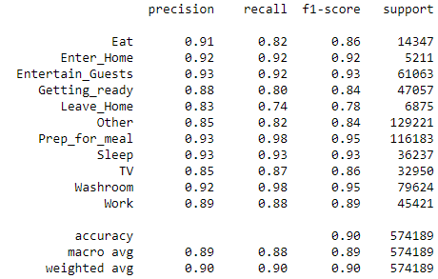
Data Modelling
XGBoost @2k epoch
Train
Test
Notes:
Best Model
Doesnt overfit
Better test accuracy
Final model
This is for 2k epoch

Slide 17
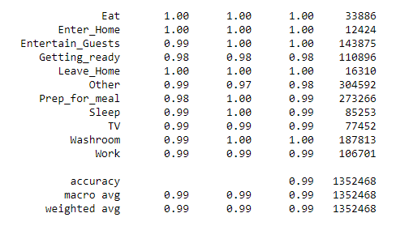
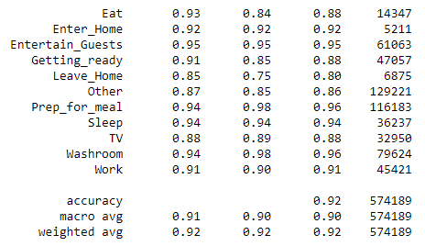
Data Modelling
XGBoost @4k epoch
Train
Test
Notes:
Model Size double at a cost of 2-3% accuracy
If better model priority then 4k epoch else 2k

Slide 18
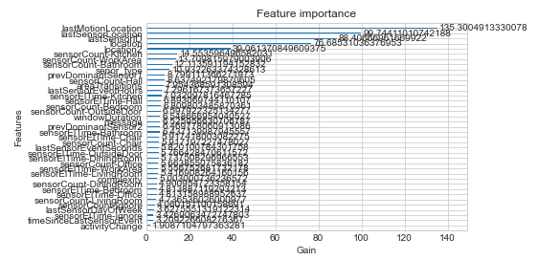
Conclusion
The Model is overfitting to over training data using Decision Tree or Random Forest algorithms.
We then tuned the hyper parameters of our models, which avoided overfitting but compromised on the test accuracy.
Using OVO and OVR approach seems to produce similar results as tune random forest.
Hence we used XGBoost as our final model, as it doesn’t overfit to our training data and also performs better in testing.

